Slide 1
The GoJupiter Project
Ingenuous Engineers

Slide 2
Roles & Contributions
John Odlum (Project Owner)
Decided which features and functionality would be developed and the order of development (Maintained the backlog).
Managed project and communicated a strong vision of our goal.
Dillon Padgett (Scrum Master)
Ensured that the team was operating in a functional and productive manner.
Assigned tasks to developers and ensured execution of each sprint.
Provided leadership and enacted scrum values and practices.
Viviana Falco, Dave Parham, Pini Vaknine (Web Developers)
Produced all vertical slices of working product functionality for each sprint.
Developed and implemented logic for the GoJupiter site.
Constructed database.

Slide 3

Site URL
http://lamp.cse.fau.edu/~vlang/gojupiter/index.php

Slide 4
Idea Behind GoJupiter
Purpose:
Provide a means of traveling to the planet Jupiter.
Motivation:
Expose people to the life that exists outside of Earth.
Functionalities:
Our site allows users to register to GoJupiter.com, book travel to Jupiter, and read/write reviews on the attractions of Jupiter.
Target Audience:
Anyone with a desire to travel to Jupiter. The motivation will be different across the diversity of ages and cultures but there is reason for all to go.

Slide 5
System Infrastructure
Languages:
HTML/CSS, PHP, XML, & JavaScript.
Database:
phpMyAdmin
Platform:
Windows, Macintosh, & Mobile.
Internet Explorer, Safari, Chrome, Firefox

Slide 6
Screen Shots of Final System

Slide 7

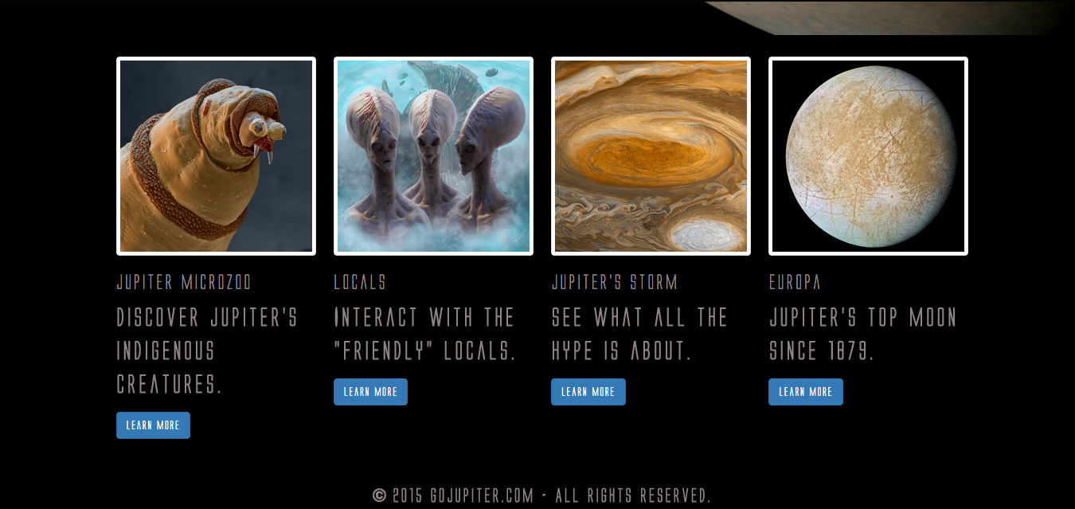
Home Page

Slide 8
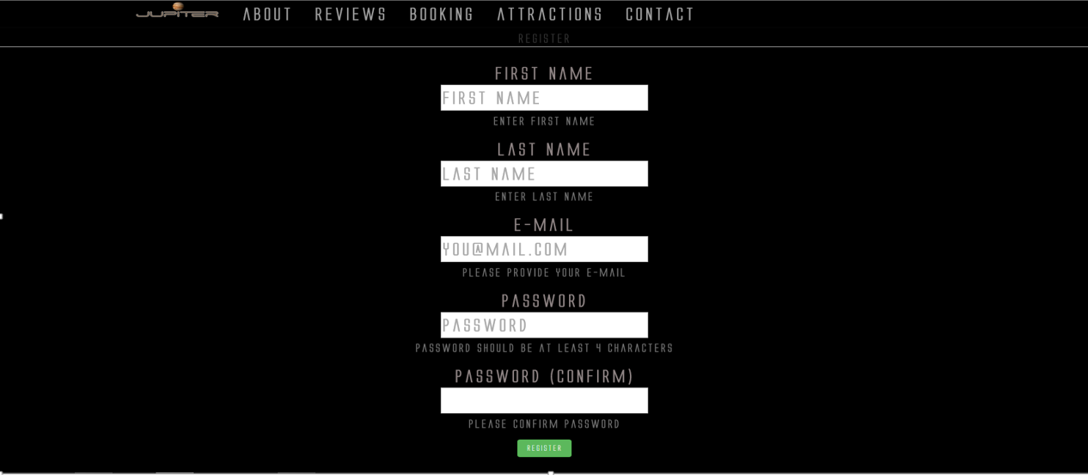
Registration

Slide 9

Book Travel

Slide 10
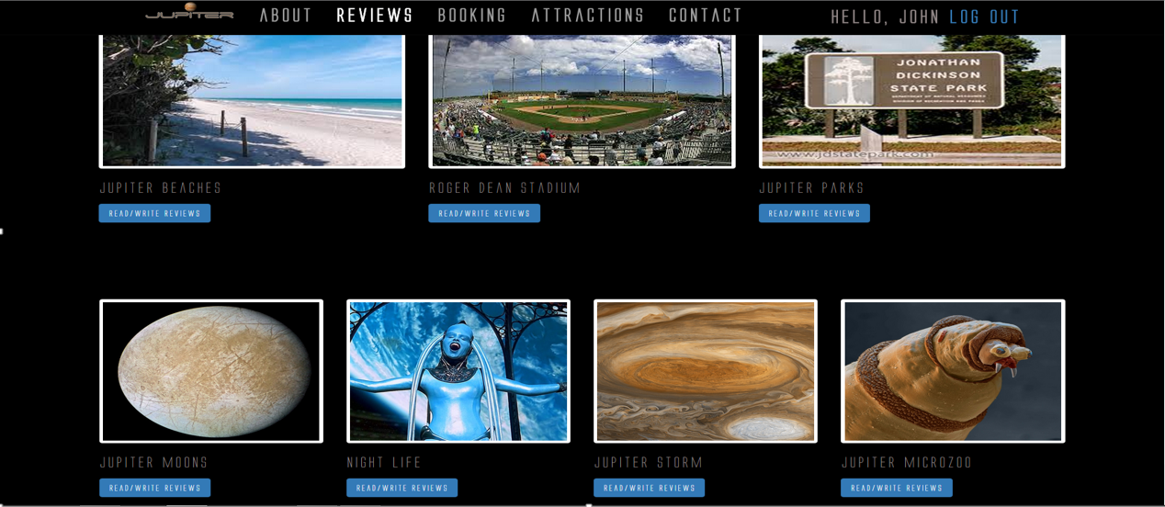
Reviews

Slide 11
Features of GoJupiter.com
Completed:
Register (Login) to GoJupiter.com
Book Travel to Jupiter
Read/Write Reviews on Jupiter attractions
Modern, user-friendly, and simplistic interface
Incomplete
Limit on concurrent users (time-constraints)

Slide 12
Team Members Contributions
John Odlum (Project Owner)
Decided which features and functionality would be developed and the order of development (Maintained the backlog).
Managed project and communicated a strong vision of our goal.
Dillon Padgett (Scrum Master)
Ensured that the team was operating in a functional and productive manner.
Assigned tasks to developers and ensured execution of each sprint.
Provided leadership and enacted scrum values and practices.
Viviana Falco, Dave Parham, Pini Vaknine (Web Developers)
Produced all vertical slices of working product functionality for each sprint.
Developed and implemented logic for the GoJupiter site.
Constructed database.

Slide 13
Lessons Learned
Working on this GoJupiter.com project we, the Ingenuous Engineers, have learned:
That Software Engineering is not only different form Software Engineering but encompasses much more than it. It involves management, project planning, risk management, scheduling, quality assurance, architectural design, and requirement management.
How to follow the Scrum process in order to deliver the highest business value in the shortest time, by following the leadership of our Product Owner, adhering to the management of our Scrum Master, and producing a working product with Development Team.
How to develop and follow User-Stories and Use-Cases that display all the ways our system would be used to achieve the goals of each user.
A good design consists of High Cohesion and Low Coupling, Exception Identification and Handling, and Fault Prevention and Tolerance.
In a team each individual has a certain skillset and the key to a successful team is recognizing those skillsets and ensuring they’re used in a most efficient fashion.

Slide 14
GoJupiter, you won’t regret it!

